Slide 1


Welcome to
University of Arizona Coding Bootcamp
Wifi Name: UAGUEST
Password: Create
Accept Invite:
uabootcampcontent.com
Open:
Slack Desktop App & Add Photo!
Welcome!
Notes:
Review deck and update with relevant information.

Slide 2
Activity: Present & Accounted For
Navigate to www.bootcampspot.com
Sign in
Click Sessions
Find Today’s Date
Mark Your Attendance
Notes:
Everyone open your browser and let’s follow these steps:
Navigate to www.bootcampspot.com
Sign in with your log-in credentials
Click “Sessions”
Find Today’s Date
And last but not least, let’s mark the official start of our journey together!
Everyone Mark Your Attendance

Slide 3
By the end of this session, you will:
Come to know your classmates as the community that you will rely on for collaborative learning.
Know the staff who will be providing holistic support throughout the program.
Understand the minimum requirements in order to successfully graduate from this boot camp.
Be able to list ways to get help and support at your moments of need.
Notes:
Delivered by SSM:
These Objectives are overarching and include Launch + 1.1 integration.

Slide 4
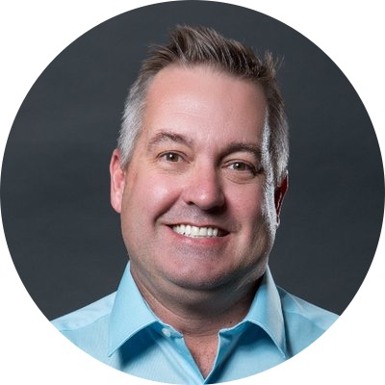
Brent Watson
Student Success Manager
“Be Fearless in Pursuit of What Sets Your Soul on Fire”-Jennifer Lee
Notes:
Delivered by SSM

Slide 5

Your turn!
In 30 seconds or less, share your
Name
Location (Live and Commuting from)
Background (Career, Education, Interests)
What is it about this class that excites you?
What is your proudest achievement?
Notes:
Student Intros

Slide 6


YOUR
CAREER SERVICES TEAM
PROFILE COACHES
CAREER COACH
YOU
Notes:
Delivered by SSM:
Intro to PC’s
Intro to CC
Primary and most important member of the CS Team is the Student themself.

Slide 7
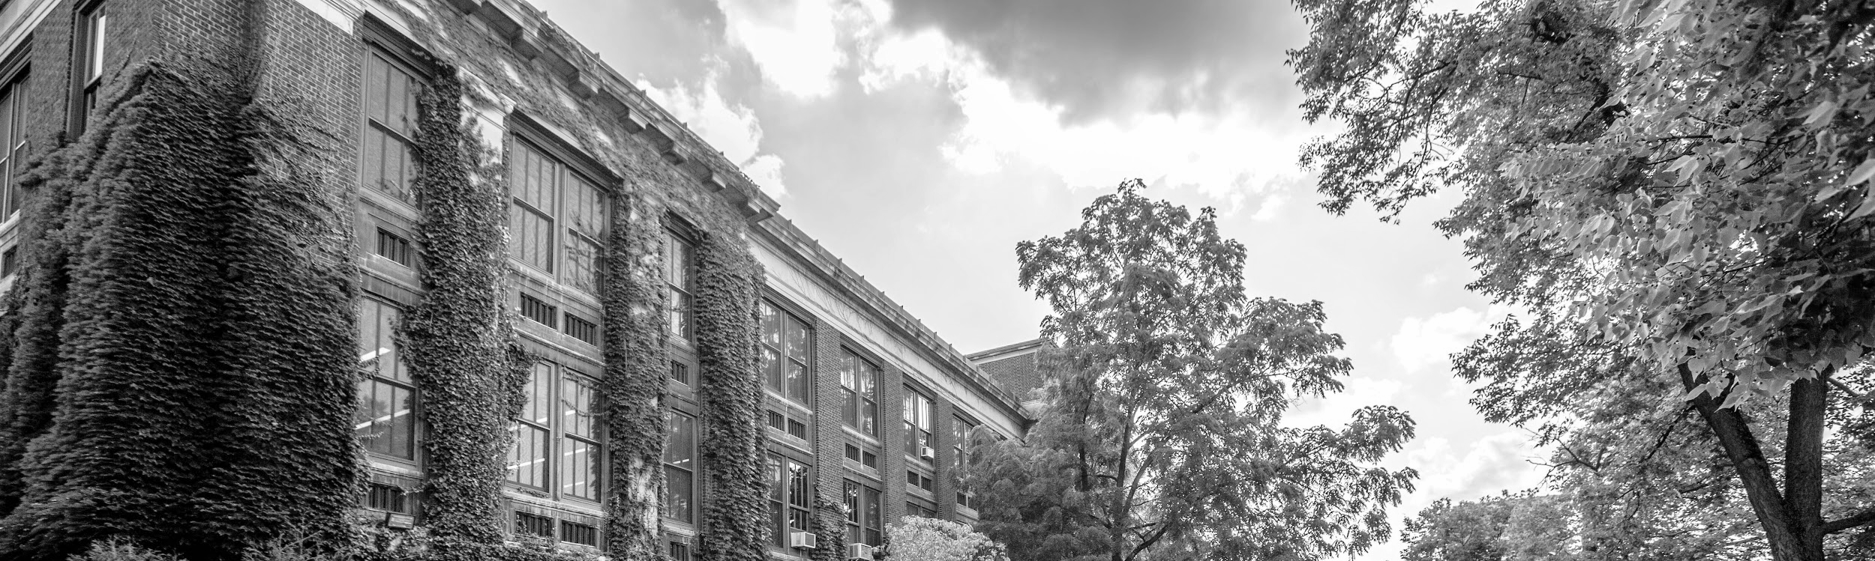

SUPPORT STRATEGIES
You are responsible for your success, but you’re not alone!
You
Schedule a Check-in with your SSM
Live Chat
on Bootcampspot
Attend Office Hours
Form Study Groups
Notes:
Delivered by SSM:
Live Chat Tools:
Financial issues
Tutoring
General Support
FAQs
State Office Hours per respective markets.
To Students: “There’s puzzle pieces left to add and that’s where you come in. What will you add to your support strategies in this course?”

Slide 8
Activity: Landing Zones
Read this, then break into groups. (We’ll direct you)
2. As a group, decide on a meeting time and place for your study group on your assigned day of the week.
3. Post day and location in your Slack and pin.
4. Choose a speaker to share your decision with the class.

Slide 9
PROGRESSION OF CAREER SERVICES
Individualized career support throughout job search
Months
7-9
Continue interviewing practice
Learn to network
Start applications!
Individualized career support throughout job search
Months
5-6
Months
3-4
Build a technical resume & portfolio
Start practicing interview skills
Months
1-2
Understand the tech industry
Develop your brand statement & online presence
Notes:
Your Career Services experience is organized around a set of 7 Milestones that will lead you to Employer Competitiveness.
Milestones include:
Create Professional Materials
Polish your Portfolio
Prepare for Successful Interviews
Build Your Visibility

Slide 10
Minimum Graduation Requirements:
Miss no more than 4 classes
Have no more than 2 incomplete homeworks
Hold at least a 70% average on homeworks
Hold at least a 70% average on group projects
Participate in all projects
Notes:
Remove % if not applicable to your university

Slide 11
COURSE TIMELINE
HTML
CSS
JavaScript
Node/Express
Mongo
Modularity
External APIs
Socket. io
Testing
React
Also React
More React
Computer Sci.
Project 1
Project 2
Project 3
Project 1:
Group Project
Full-stack (MEN)
External Library
Project 2:
Group Project
Real-time DB
External API/Library
Project 3:
Group or Individual Project
React (MERN)
External API/Library

Slide 12

Session Objectives Completed:
Come to know your classmates as the community that you will rely on for collaborative learning.
Know the staff who will be providing holistic support throughout the program.
Understand the minimum requirements in order to successfully graduate from this bootcamp.
Be able to list ways to get help and support at your moments of need.
Notes:
Delivered by SSM:
These Objectives are overarching and include Launch + 1.1 integration.

Slide 13
Pre-Work
Notes:
.

Slide 14

Break
See you back in 15 minutes!

Slide 15
Software Checklist
At this point, you should have each of these installed:
Slack
Visual Studio Code
Git for Version Control
Git Bash (Windows) or Terminal (Mac)
Node.js
Heroku-CLI
Google Chrome

Slide 16
Accounts Checklist
You should also now have accounts for:
GitHub (with SSH Integration)
Heroku
LinkedIn
Stack Overflow

Slide 17
Self-Check
Let’s do some quick checks of the following
Visual Studio Code Check
Git Bash / Terminal Check
Node Check
Git Check
Heroku Check

Slide 18
On the Modern Web

Slide 19
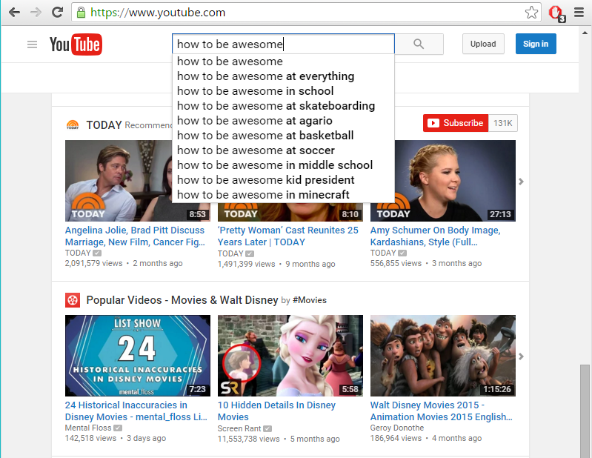
The “Magic” of YouTube
Notes:
Let’s use YouTube as an example. (Go to YouTube and do basic search)
You’ll learn all of this in time, but a basic YouTube search requires two things:
A ”frontend” – the graphical user interface which responds to what I type
A “backend” – the code on the “server side” that is able to do the logic behind the search, find the relevant videos, and send them along
(Go to next slide)

Slide 20
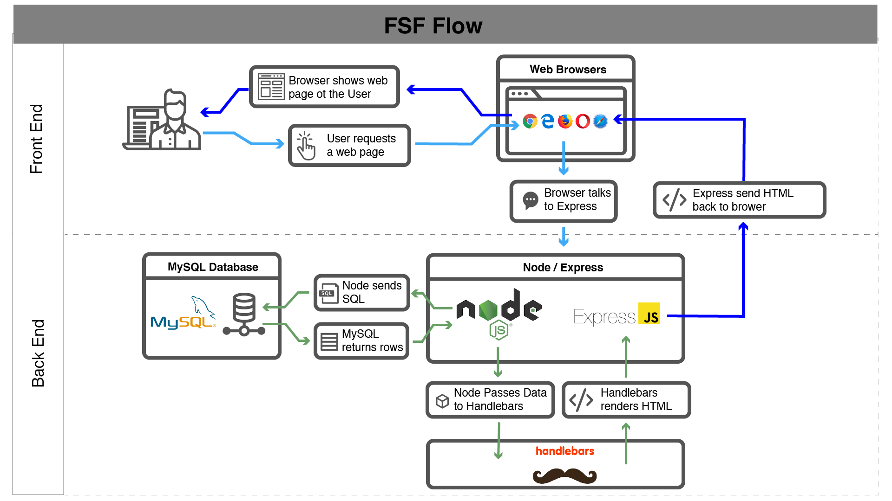
Full-Stack Development
In modern web apps, there’s a constant back-and-forth communication between two key components: the visuals displayed on the user’s browser (frontend) and the data and logic stored on the server (backend).
Notes:
Websites today are all about reading code for these components – “front end” and “back end”

Slide 21
Full-Stack Development
Full-Stack Development is the concept of building every aspect of the web application – from the visuals and interactions, to the data transfer and processing.
Notes:
That is “Full-Stack Development” – you build can and will build the whole thing.

Slide 22
Full-Stack Development
The Browser
Dev Tools
Server Side
HTML
CSS
JavaScript
jQuery
Bootstrap
SEO
Heroku
Git
GitHub
Templating Engines
Sessions
Writing tests
Node.js
Express.js
Creating APIs
MVC
User Authentication
ORM (Sequelize)
Databases
MySQL
MongoDB
API Interaction
APIs (Consuming)
JSON
AJAX
Real Time Cloud Database via Firebase
Algorithms
Design Patterns
CS Fundamentals
Cutting Edge Development
React.js
Notes:
In this course, you’ll learn everything you need to be able to do this –
you’ll be able to build complex web applications even as a single developer.
Questions?

Slide 23
Let’s Get Crackin’

Slide 24
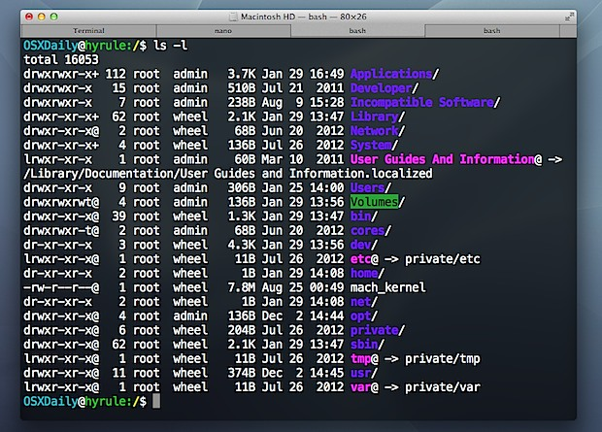
Intro to Console / Terminal
Notes:
The terminal is the portal to your computer – it allows you to run and even script commands that can create files, folders, and more.
It is extremely important that you get intimately familiar with the terminal as soon as possible, as you’ll use it for almost everything. It is fast and powerful.
NEXT

Slide 25
INSTRUCTOR DEMO
Instructor: Demo
(1-ConsoleCommands)
Notes:
So let’s run through a couple of examples.

Slide 26
> YOUR TURN!
Activity: Get Situated | Suggested Time: 1 min
Assignment:
Make a folder on your desktop named code.
Put all of your code that you do inside of that folder.
Best Practices:
Always use lowercase for folder and file names.
Never put in spaces in your folder and file names.
Use dashes to separate.
Notes:
Your turn!

Slide 27
> YOUR TURN!
Activity: Console Commands | Suggested Time: 12 min
Assignment:
From the Terminal / Console and using only the command line, create:
A new folder with the name of first_day_stuff.
A new HTML file with the name of first_day.html.
Open the current folder containing the new HTML file.
Bonus:
Create multiple directories/folders with the names one_folder and second_folder in one command.
Create multiple files with the names one.html and two.html in one command in the first_day_stuff directory.

Slide 28
Intro to Console
Discuss with Neighbors
Notes:
Re-ask the questions after a couple of minutes walking neighbor-discussion:
How do you create a new folder?
How do you create a new file?

Slide 29
Hello, HTML
Notes:
Now that you can create HTML files from the terminal, let’s create one and actually write some HTML.

Slide 30

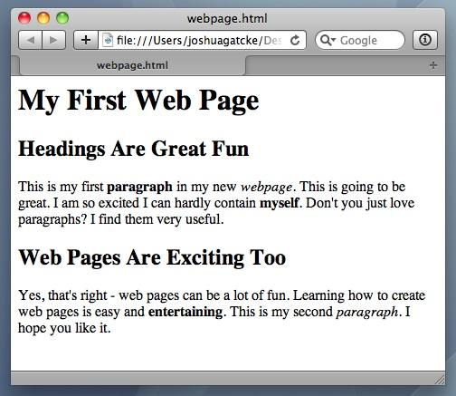
<title> Intro to HTML </title>
HTML is one of the three base languages behind every single website.
It defines all of the basic content and a bit of formatting.

Slide 31
> YOUR TURN
Assignment:
In a new HTML file, create the basic structure of an HTML document and include the following in it:
DOCTYPE declaration.
Head tag with a title tag.
H1 tag with a title of your choice.
Embed an image.
Create the following three links on your page:
One link that has target="_blank" which opens a new tab when clicked
Make the second link bold.
Make the third link a placeholder so it goes nowhere.
Bonus:
Create an ordered list of steps to make a sandwich.
Create an unordered list of 5 bands/musicians you like.
Create a table with 2 columns (animal class and animal name) and 4 rows of animals.
Use an alternate way of separating links without line breaks.
Embed a YouTube video of your favorite band/musician.

Slide 32
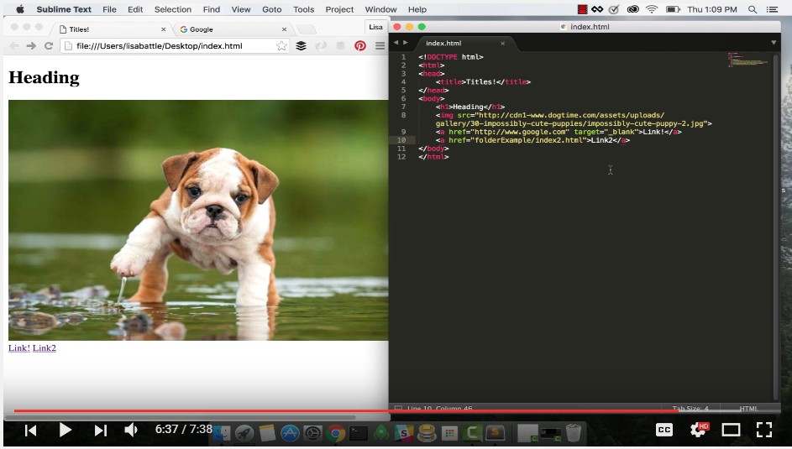
YouTube Video Walkthrough!
https://www.youtube.com/watch?v=ieb6Svbc10E&index=1&list=PLgJ8UgkiorCnMLsUevoQRxH8t9bt7ne14

Slide 33
<title> Intro to HTML </title>
How’d it go?

Slide 34
Homework

Slide 35
Homework “Due”: Next Class
By Next Class:
Figure out where the GitLab Repo is for our class.
Re-do the Terminal example from class today.
Re-do the HTML example from class today.
Watch the Walkthrough Video if you felt a bit lost.

